Slide 1
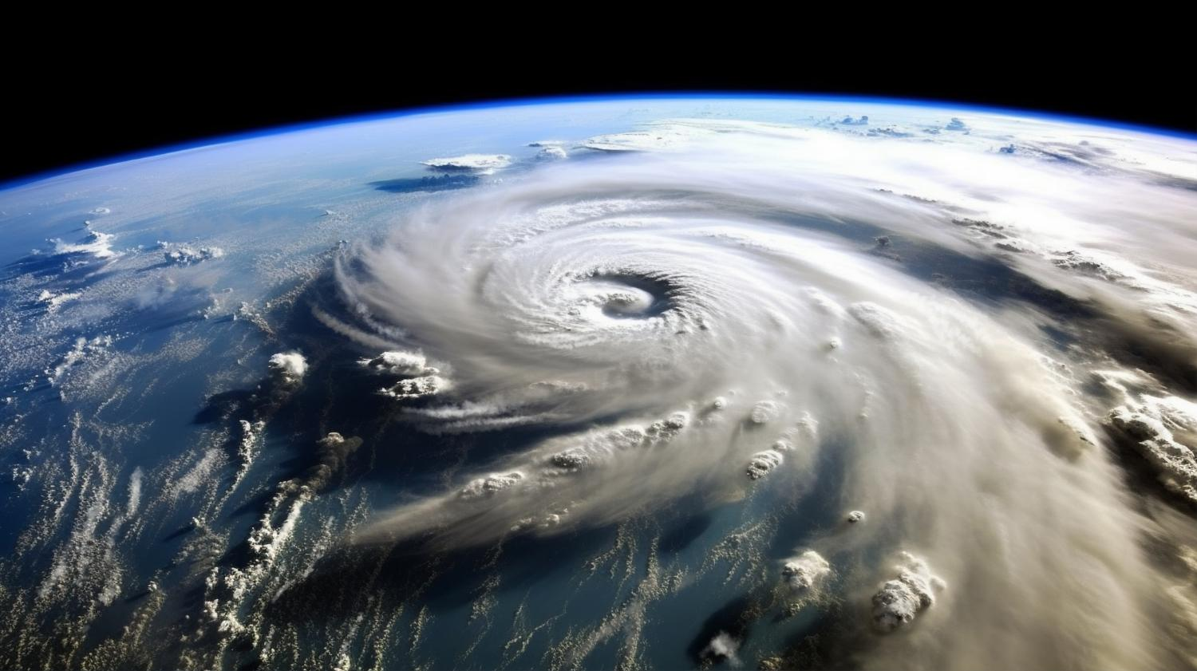
Social Network Analysis in Natural Disaster Response and Recovery
Munteanu Bianca-Ștefania

Slide 2

INTRODUCTION
Role of SNA in Disaster Management
Map and analyzes social connections during preparation, response, and recovery phases.
Identifies key nodes and connectors essential for effective communication and resource distribution.
Enhances understanding of community resilience.
Notes:
As a short introduction I will discuss the Role of Social Network Analysis in Disaster Management
Its main role is to

Slide 3
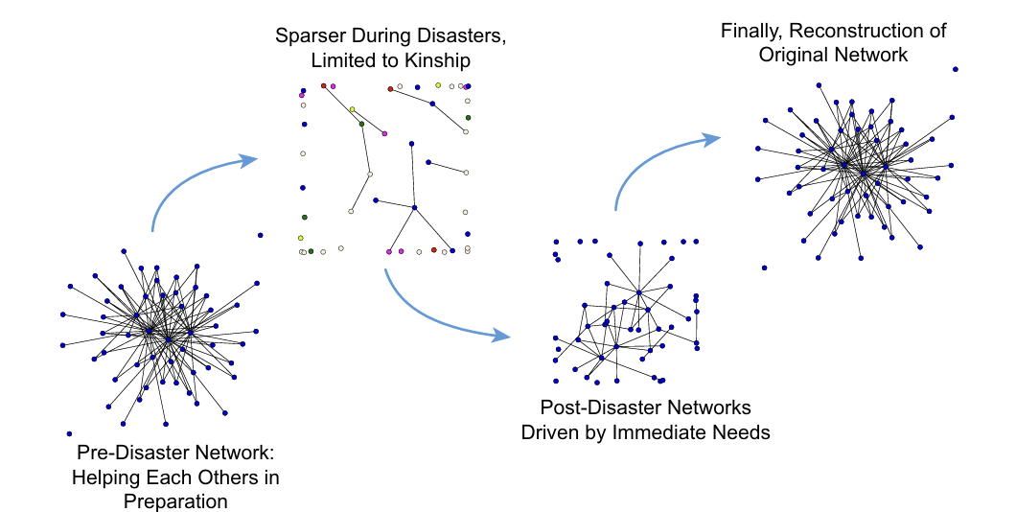
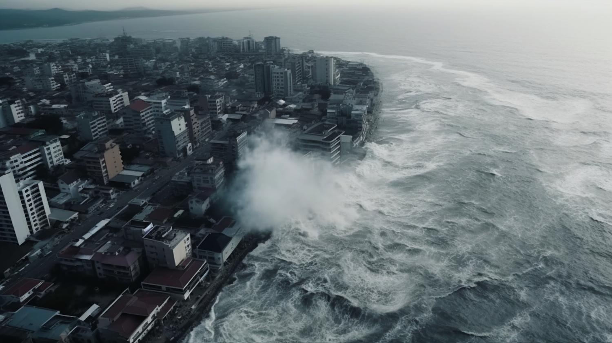
Network Dynamics
Pre-Disaster
Dense networks are built on routine interactions and trust.
During Disaster
Networks become sparser but more agile, forming new ties based on urgent needs.
Post-Disaster
Networks reorganize, integrating new and existing ties, enhancing community resilience for future adversities.
Evolution of a network pre, during, and post disasters
Notes:
On this slide we can see how network dynamics evolve in 3 stages...

Slide 4
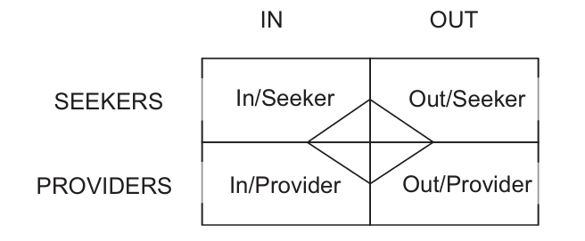
IOSP Framework: Understanding Roles and Interactions
In/Seekers
Out/Seekers
External entities outside the disaster zone seeking to contribute with resources or obtain information.
Eg: Distant family members, international aid organizations
Individuals/groups within the disaster zone seeking help, information, or resources.
Eg: Local survivors and affected households
In/Providers
Out/Providers
Members within the disaster area providing support, services, or resources.
Eg: Local government bodies, community organizations, local NGOs.
External supporters providing aid and resources from outside the disaster area.
Eg: National governments, international NGOs, external donors.

Slide 5
Case Study: Aila cyclone (2009)
Study Focus
Analysis of social networks post-Cyclone Aila (2009) and their role in community resilience.
Methodology
Data Collection: Personal interviews with affected households, focus group discussions.
Phases: 'Extreme event,' 'immediate response,' 'relief,' 'rehabilitation,' pre- and post-disaster.
Nodes and Edges:
Nodes: Individuals, households, government agencies, NGOs, political affiliates.
Edges: Kinship, friendship, information exchange, aid provision.

Slide 6
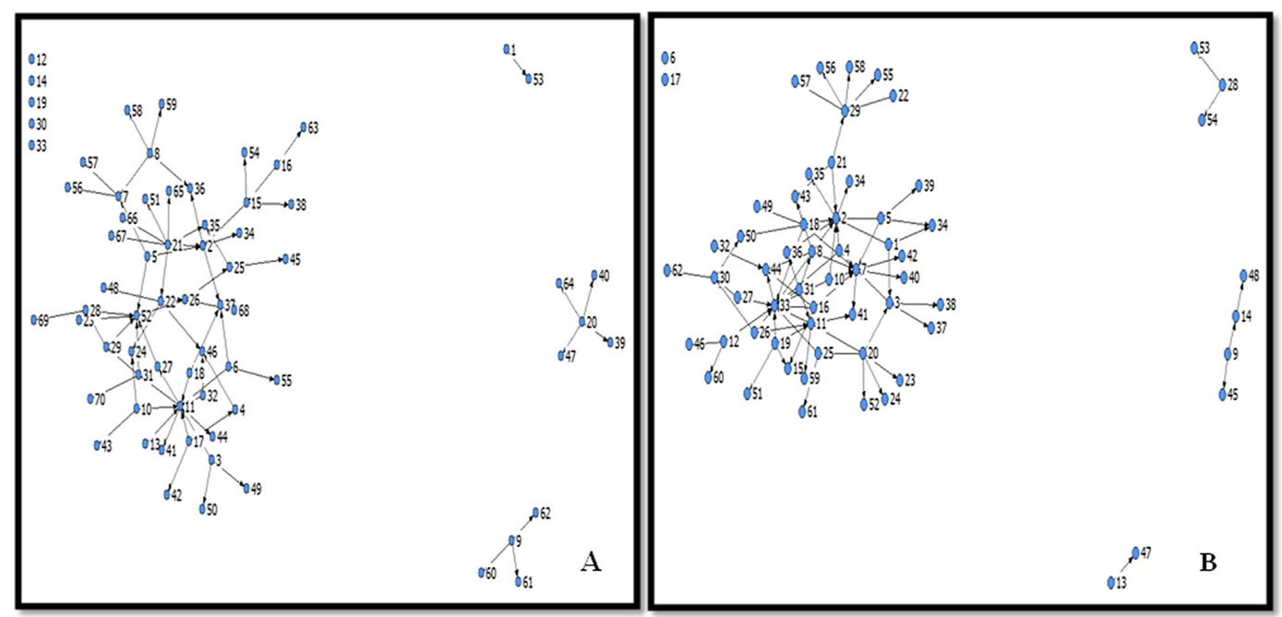
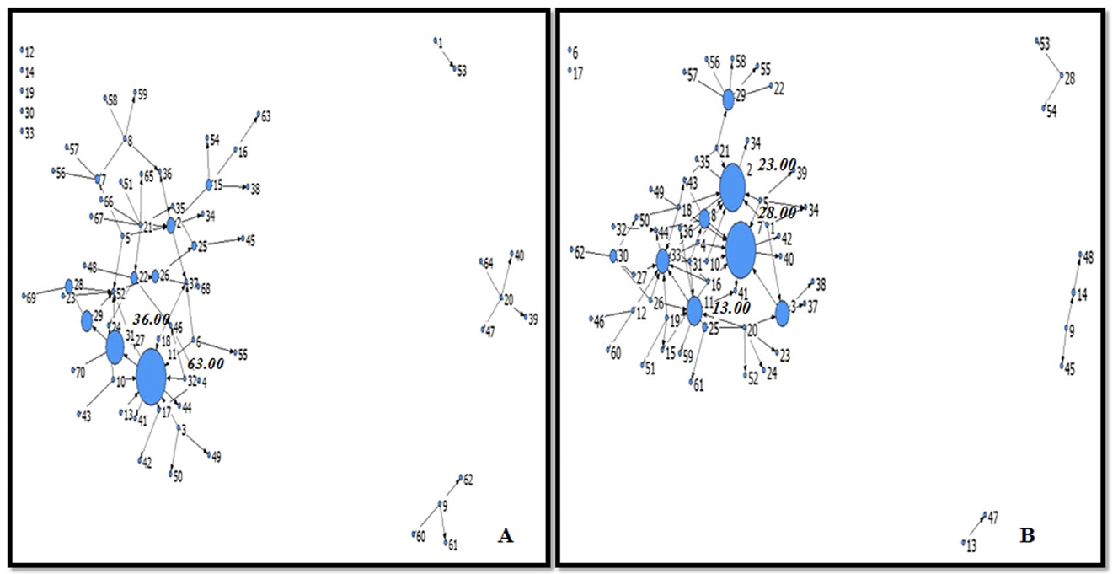
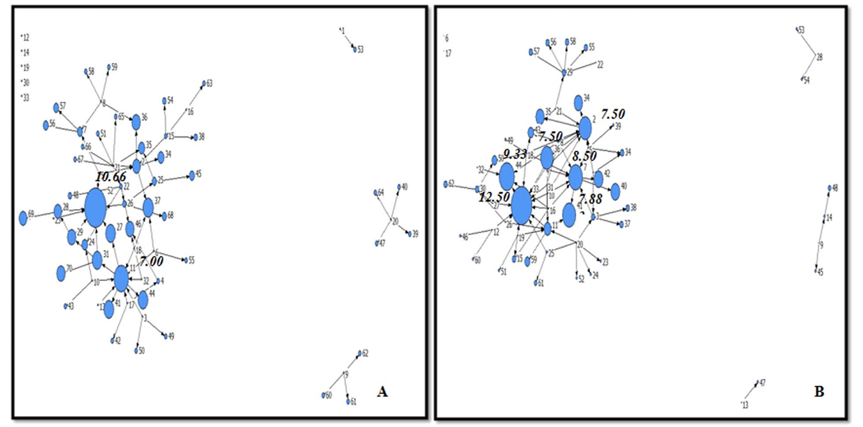
Social networks before (A) and after (B) the disaster
Betweenness Centrality before (A) and after (B) the disaster
InDegree Centrality before (A) and after (B) the disaster
Closeness Centrality before (A) and after (B) the disaster
Notes:
Here we have some graphics on different centrality measures across the network, before and after the disaster

Slide 7
Key Findings: Aila cyclone (2009)
Network Dynamics
Community Networks
Post-Disaster: Increased network density and centrality.
Early Response: Managed by community's intrinsic networks.
Evolution: Key actors emerged over time, facilitating information flow and support.
Shift in Central Actors
Long-Term Changes
Post-Disaster: New central actors (often external and politically affiliated) helped access public resources.
Increased Density: Some emergency ties remained, enhancing the community network.
Notes:
- It was observed that in the post-disaster network, density and centrality were increased
- Also, the early response was managed by community intrinsic networks, while key actors emerged over time
- there was also a shift in the central actors in post-disaster phase, where external actors helpe access public resources
- And some emergency ties remained, even on long term plan

Slide 8
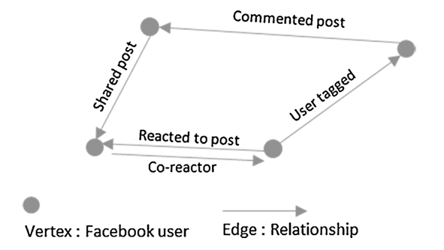
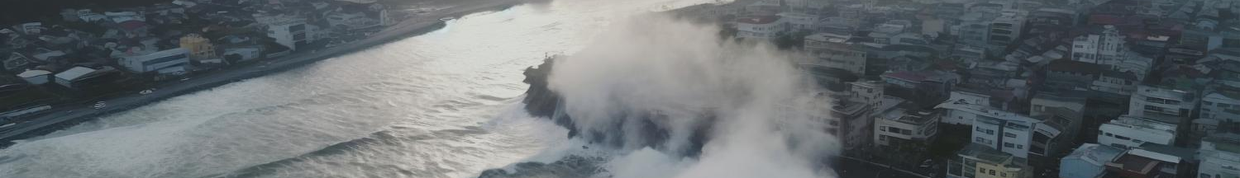
Case Study: Louisiana Flood (2016)
Study Focus
Analyzed user behavior and the structure of online communities on Facebook during the 2016 Louisiana floods.
Methodology
Data Collection: Data mining from the City of Baton Rouge's Facebook page, analyzing posts, comments, reactions, and networks formed around shared content.
Nodes and Edges
Nodes: Individual Facebook users, key actors, and organizations.
Edges: Relationships such as posts, comments, reactions, and tags.

Slide 9
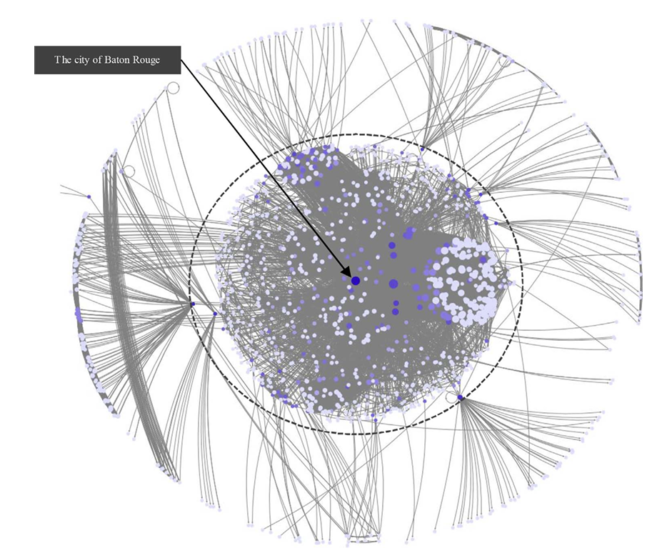
Key Findings: Louisiana Flood (2016)
Role of Individual Users
Individual Facebook users played a central role in disseminating information, especially immediately after the flood.
Community Formation
Despite a decrease in interactions over time, the structure of the networks remained intact, indicating the formation of a lasting community of support.
Identification of Key Actors
Key actors and organizations within the network were identified by their high centrality and betweenness, marking them as major information disseminators and connectors.
Network graph during the disaster, highlighting the users and organizations with the highest out-degree centrality (those who shared information most frequently)

Slide 10
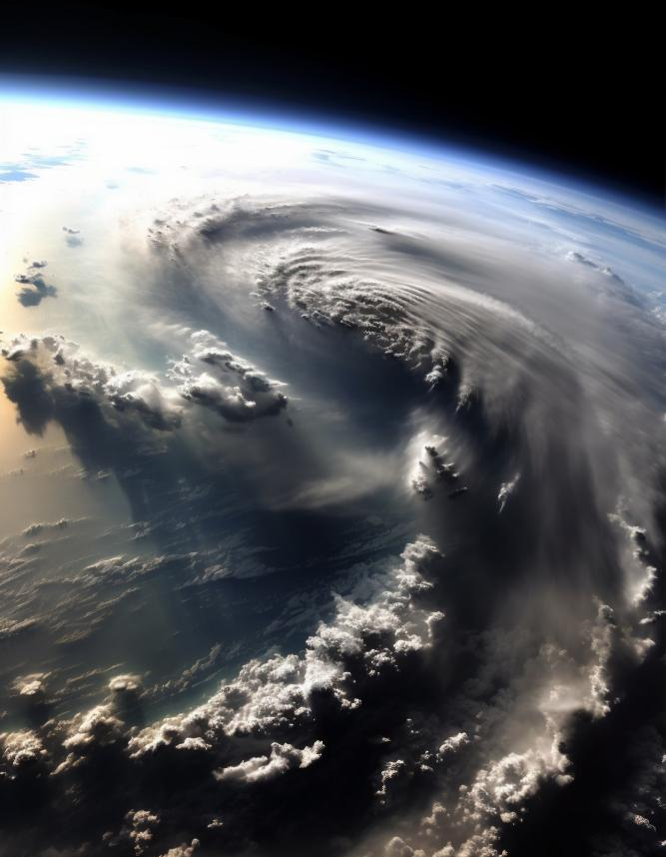
Case Study: Hurricane Harvey (2017)
Study Focus:
Examined how government and emergency management organizations used Twitter during Hurricane Harvey.
Methodology
Data Collection: Analyzed official tweets from 67 organizations over three weeks (pre-, during, and post-disaster).
Approach: Semantic network analysis grounded in Situational Crisis Communication Theory (SCCT).
Nodes and Edges:
Nodes: Government and emergency management organizations, key actors like weather services, federal agencies (e.g., FEMA).
Edges: Tweets and retweets, mentions, hashtags, and information exchanges.

Slide 11
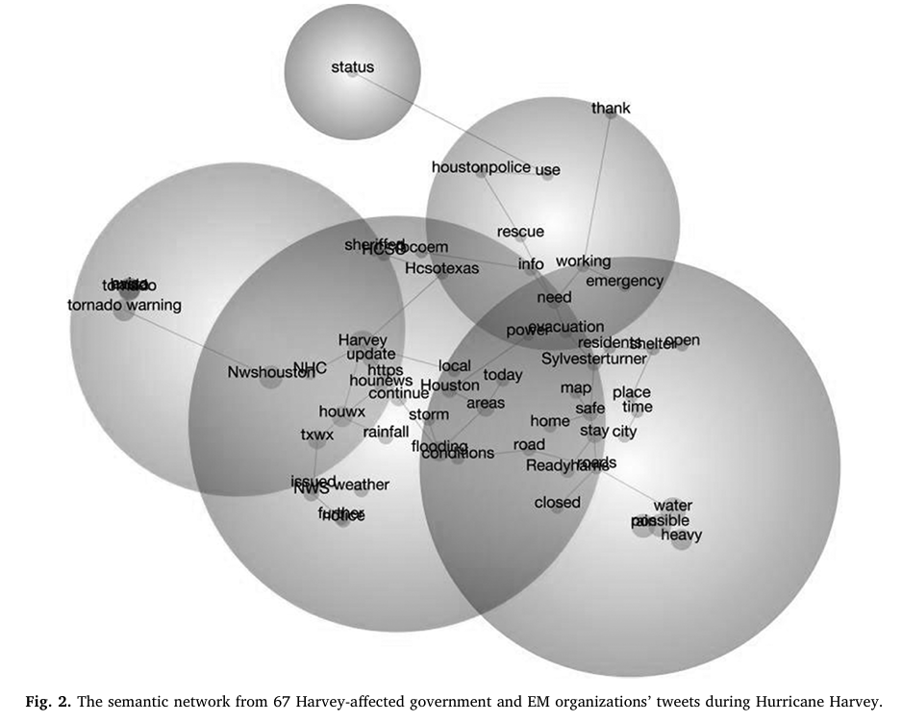
Key Findings: Hurricane Harvey (2017)
Pre-Disaster
Focus on disaster preparation.
Frequent mentions of weather services and preventive instructions.
Weather agencies are central in the network.
During Disaster
Focus shifted to real-time updates, assistance needs, and safety instructions.
Post-Disaster:
Focus on community morale, solidarity, and coordinating recovery efforts.
Shift toward community rebuilding and recovery.
The semantic network of during-hurricane tweets

Slide 12

Case Study: Sri Lanka Floods (2017)
Study Focus
Examined the role of social support networks in flood disaster preparedness and recovery in rural Sri Lanka, particularly after the 2017 floods.
Methodology:
Data Collection: Questionnaire surveys, semi-structured interviews, focus group discussions, and field observations with flood-inundated households.
Focus: Characteristics and changes in social networks over time, focusing on the exchange of information, food, water, evacuation, and shelter.
Nodes and Edges:
Nodes: Individuals, groups (e.g., Governmental Non-Officials (GNOs), volunteers).
Edges: Relationships or exchanges of support such as information, food, water, and shelter.

Slide 13
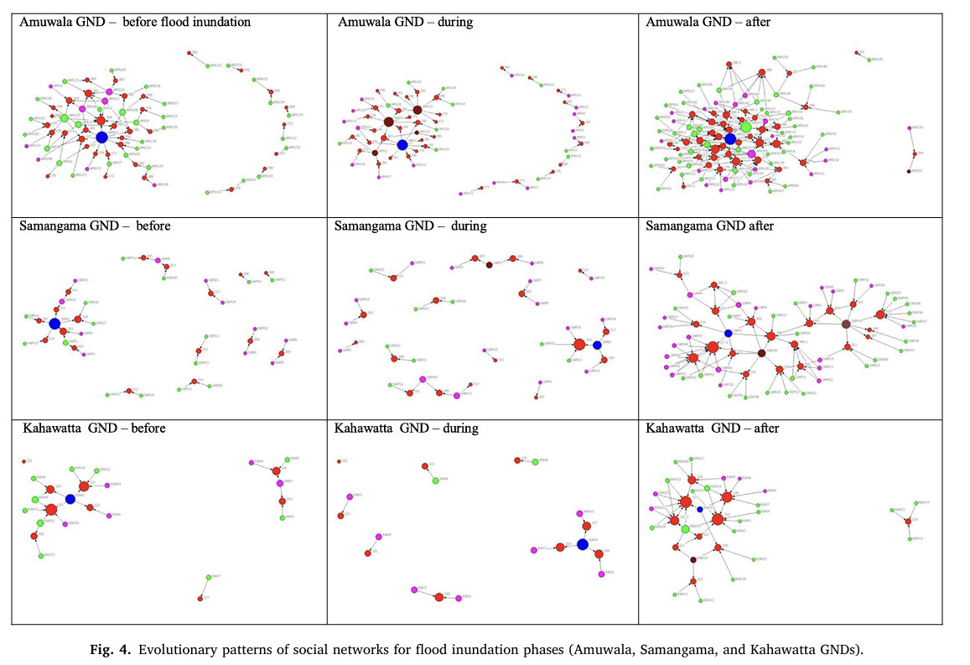
Key Findings: Sri Lanka Floods (2017)
Network Dynamics
Varied by geographic location; remote areas faced greater challenges.
Community Networks:
Initial response managed by community's inherent structure.
Evolved to include external key actors over time.
Role of Key Actors:
GNOs and volunteers played central roles in support coordination.
Post-Disaster Network Characteristics:
Denser than pre-disaster networks; some emergency ties became permanent.
Evolutionary patterns of social networks for flood phases

Slide 14
Bibliography
[1] | E. C. Jones and A. Faas, "Chapter 2 - Social Network Analysis Focused on Individuals Facing Hazards and Disasters," in Social Network Analysis of Disaster Response, Recovery, and Adaptation, Butterworth-Heinemann, 2017, pp. 11-23.
[2] | E. C. Jones and A. Faas, "Chapter 3 - Interorganizational Networks in Disaster Management," in Social Network Analysis of Disaster Response, Recovery, and Adaptation, Butterworth-Heinemann, 2017, pp. 25-39.
[3] | E. C. Jones and A. Faas, "Chapter 4 - Strategies for Researching Social Networks in Disaster Response, Recovery, and Mitigation∗," in Social Network Analysis of Disaster Response, Recovery, and Adaptation, Butterworth-Heinemann, 2017, pp. 41-56.
[4] | J. Kim and M. Hastak, "Social network analysis: Characteristics of online social networks after a disaster," International Journal of Information Management, vol. 38, pp. 86-96, 2018.
[5] | W. Liu, . C.-H. Lai and W. (. Xu, "Tweeting about emergency: A semantic network analysis of government organizations’ social media messaging during Hurricane Harvey," Public Relations Review, vol. 44, pp. 807-819, 2018.
[6] | S. Misra, R. Goswami, T. Mondal and R. Jana, "Social networks in the context of community response to disaster: Study of a cyclone-affected community in Coastal West Bengal, India," International Journal of Disaster Risk Reduction, vol. 22, pp. 281-296, 2017.
[7] | A. Y. Karunarathne and G. Lee, "The geographies of the dynamic evolution of social networks for the flood disaster response and recovery," Applied Geography, vol. 125, 2020.

Slide 15
Thank you!

